Slide 1
Wasail
Demand Forecasting System

Slide 2
Introduction
Inadequate communication between vendors and grocery stores, along with imprecise inventory orders, hampers food supply chain efficiency
Inventory Mismanagement
Conventional Procurement Structure
Communication Issues

Slide 3
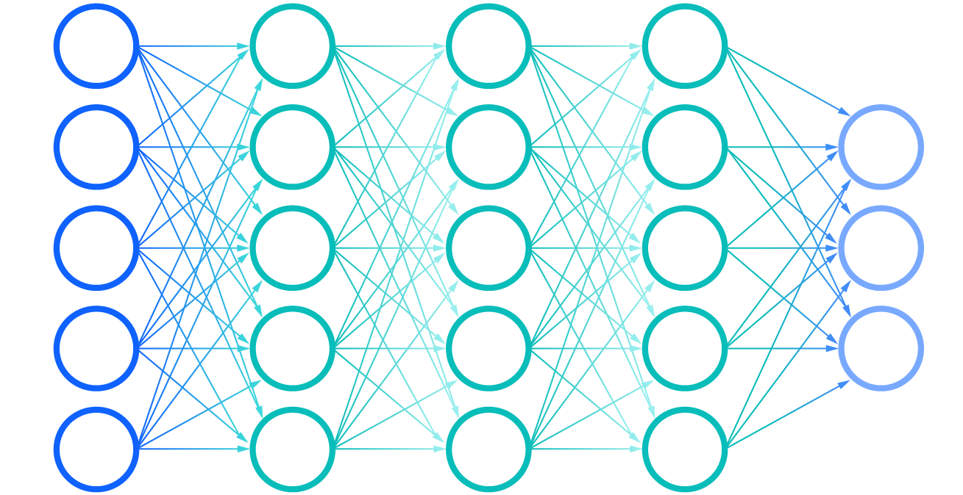
Machine Learning
Data Collection
Feature Engineering
Model Training
Deployment

Slide 4
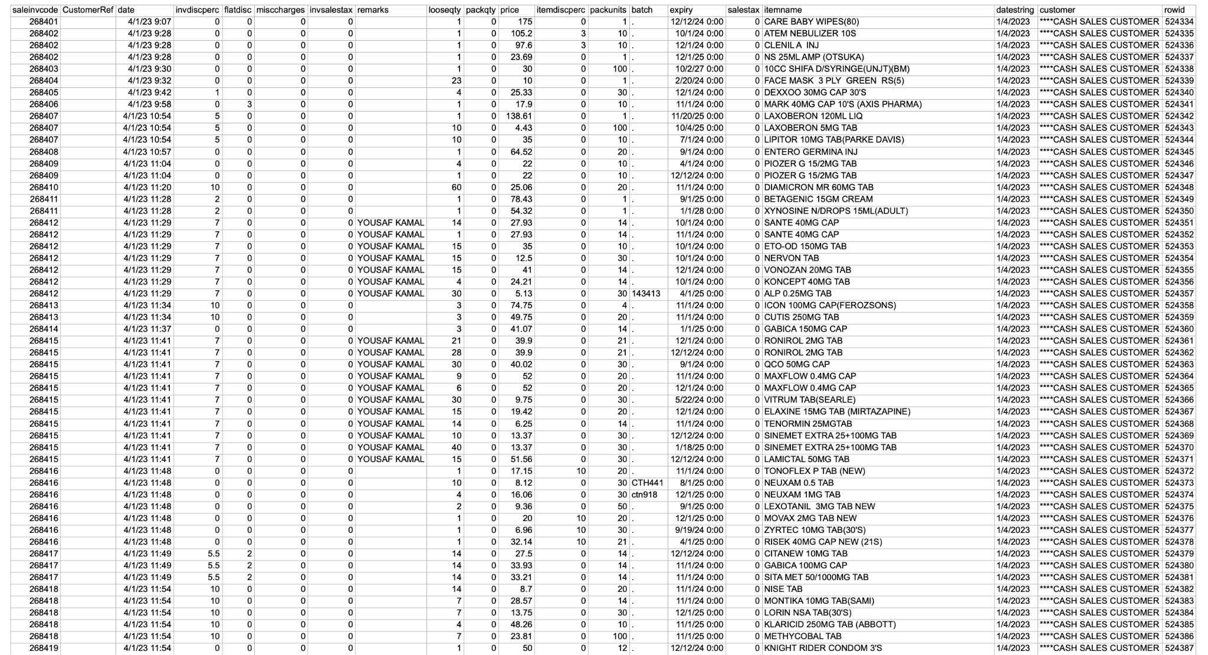
Data Collection: Pharmacy

Slide 5
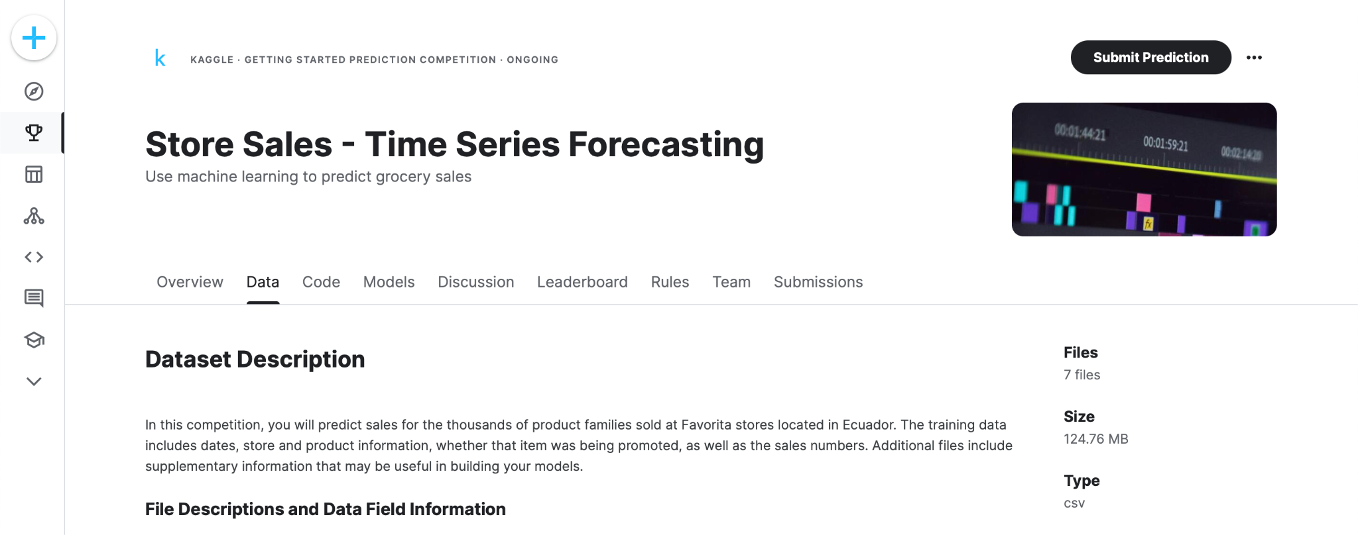
Data Collection: Kaggle

Slide 6
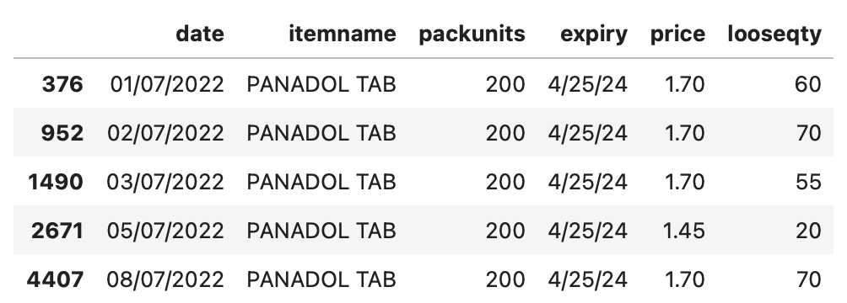
Feature Engineering: Pharmacy

Slide 7
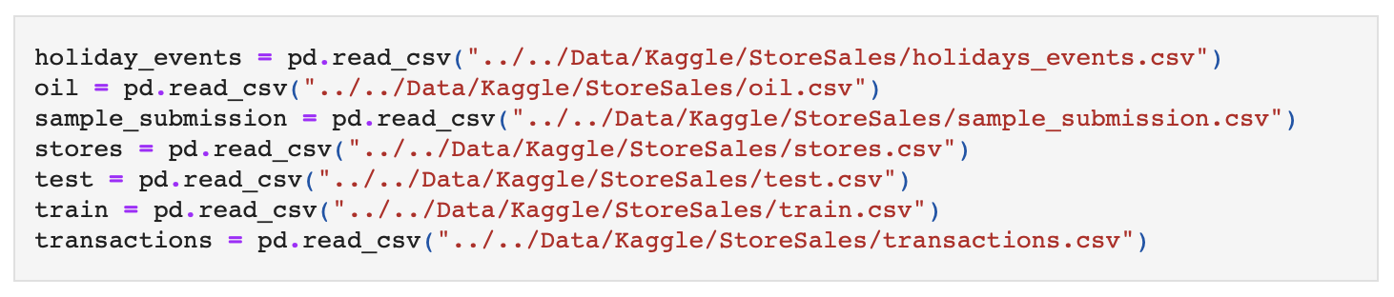
Feature Engineering: Kaggle

Slide 8
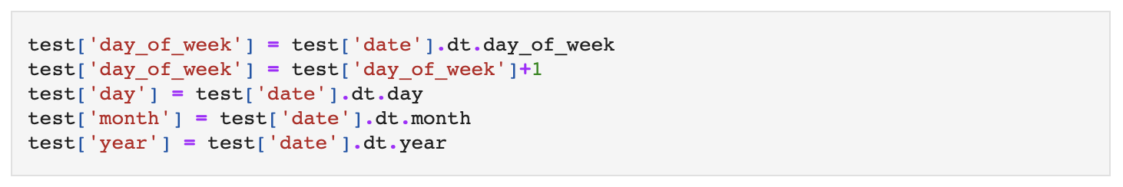
Feature Engineering: Kaggle

Slide 9
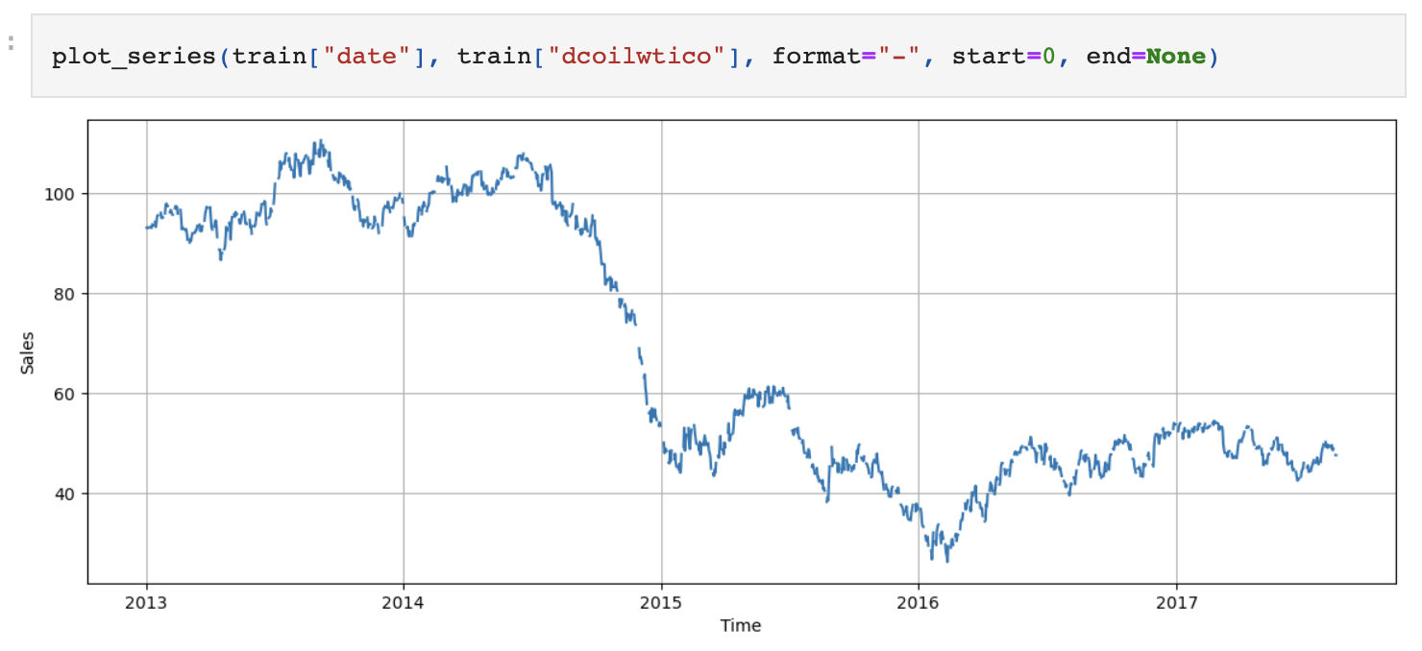
Feature Engineering: Kaggle

Slide 10
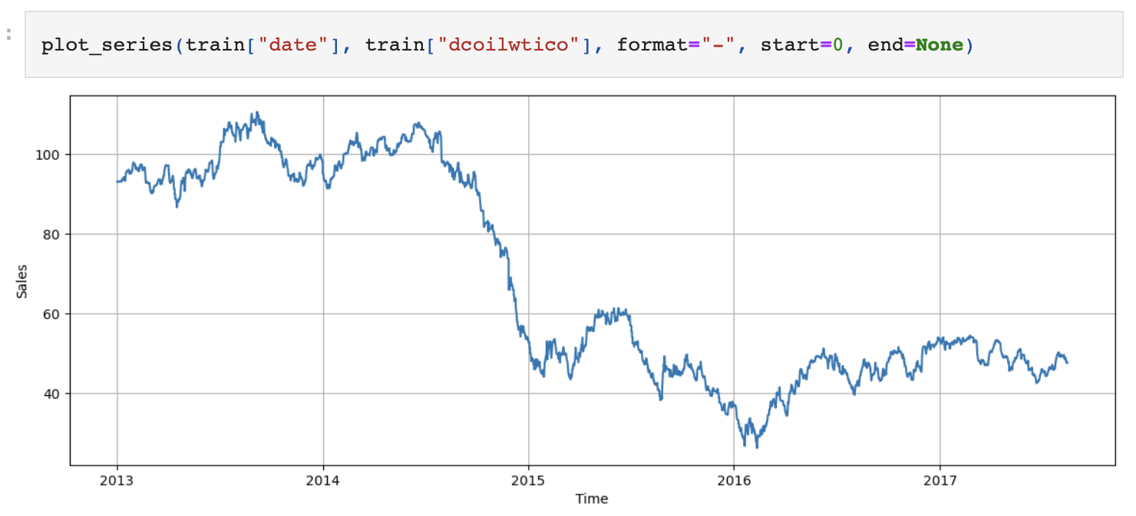
Feature Engineering: Kaggle

Slide 11
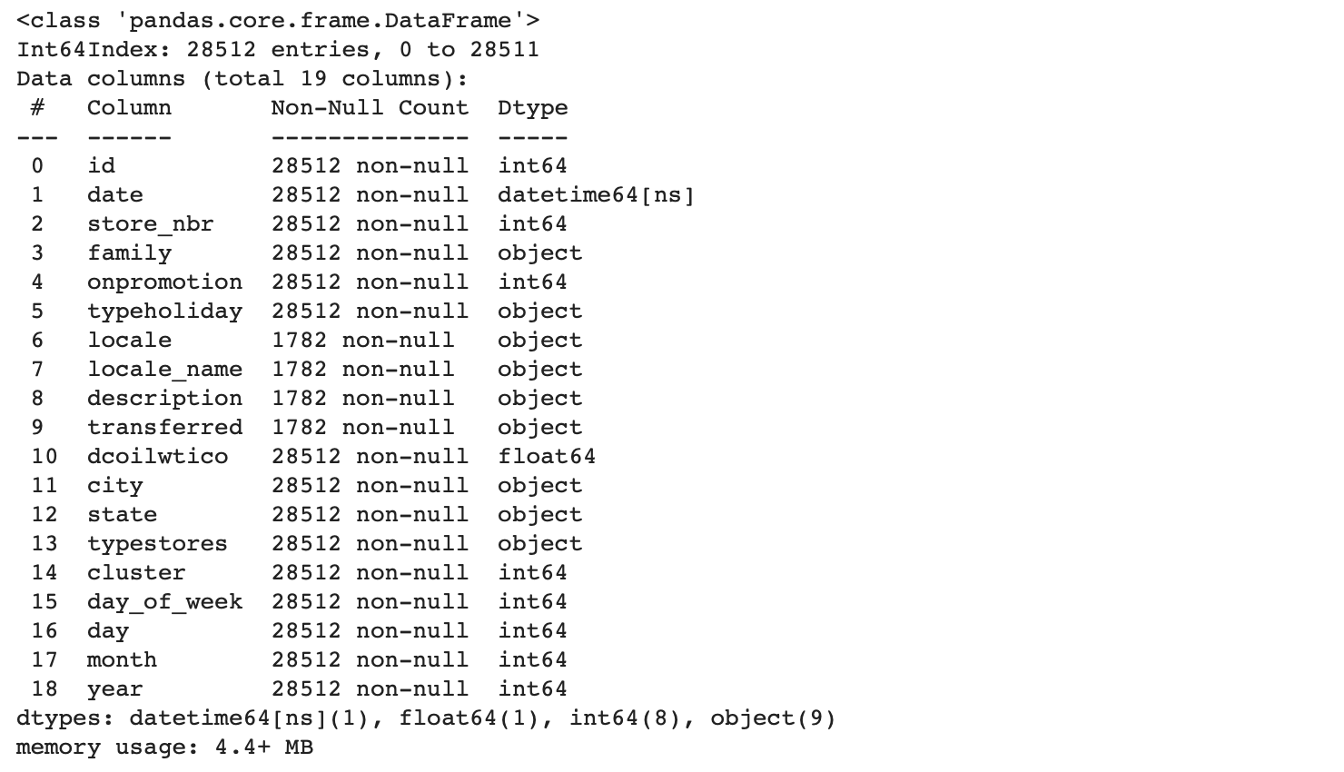
Feature Engineering: Kaggle

Slide 12
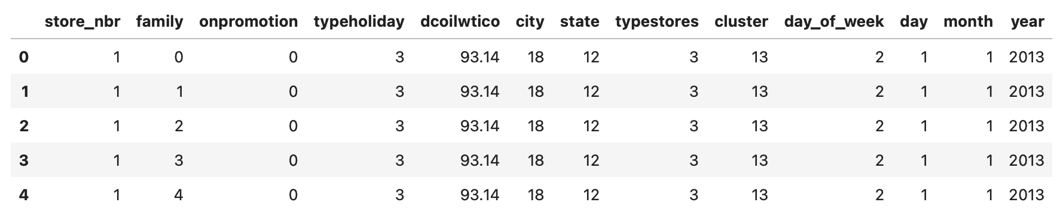
Feature Engineering: Kaggle

Slide 13
Model Training
Ensemble Learning Algorithms:
Random Forest
XGBoost
Time Series Forecasting Models:
Facebook Prophet
Recurrent Neural Networks:
Long Short-Term Memory (LSTM)
Gated Recurrent Units (GRU)

Slide 14
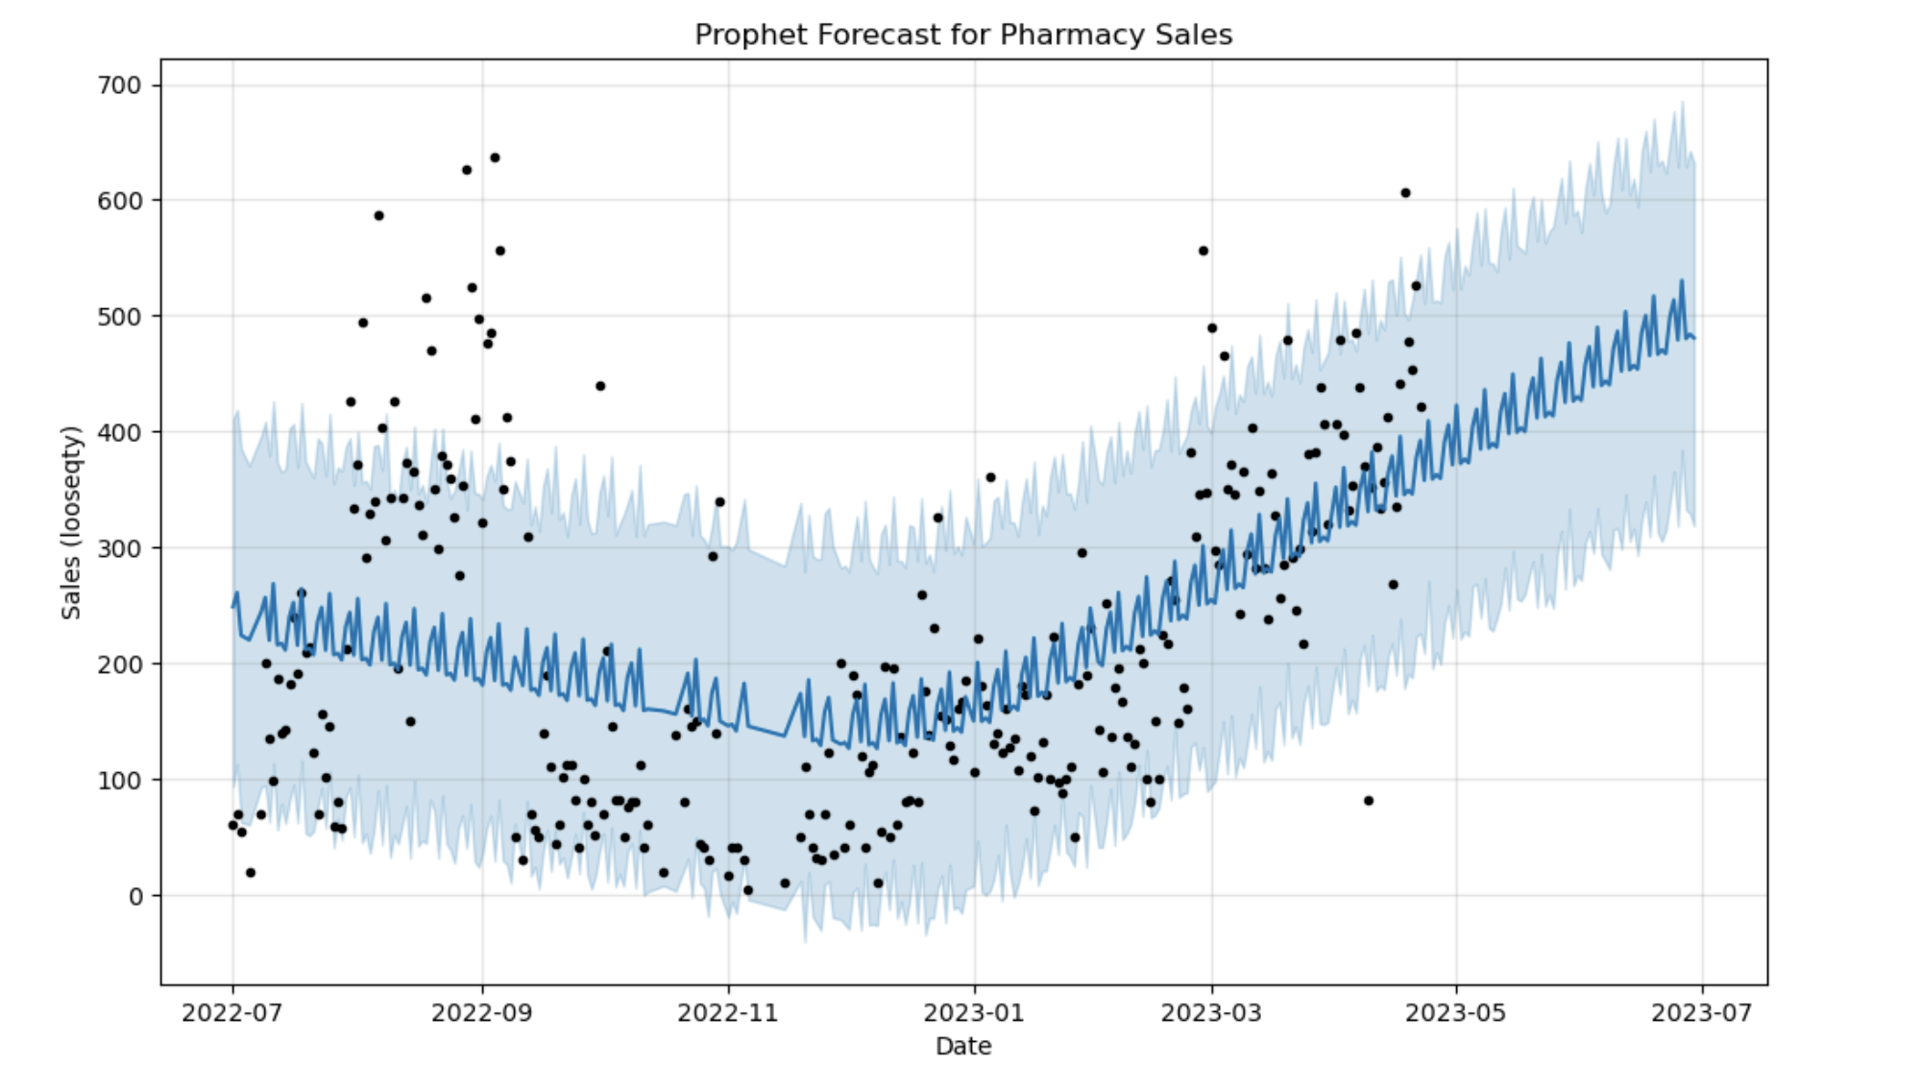
Model Training: Facebook Prophet
RMSLE: 0.401

Slide 15
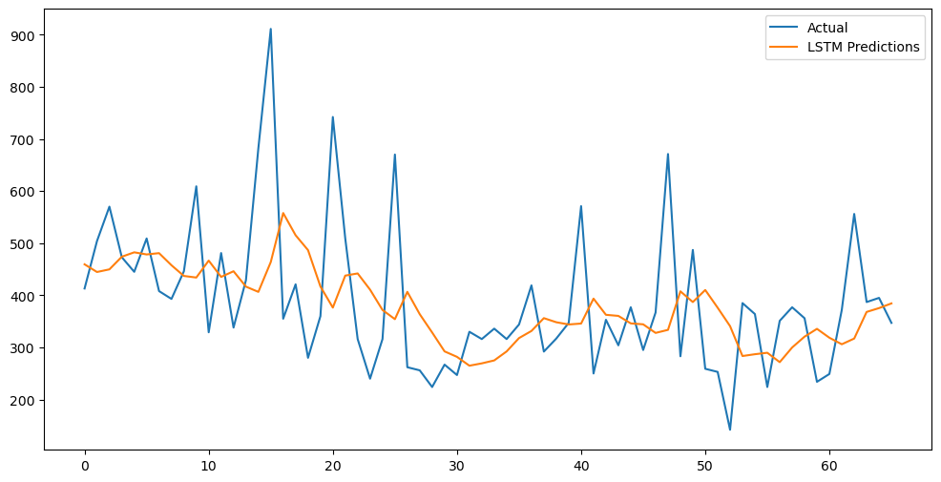
Model Training: LSTM (Univariate)
RMSLE: 0.326

Slide 16
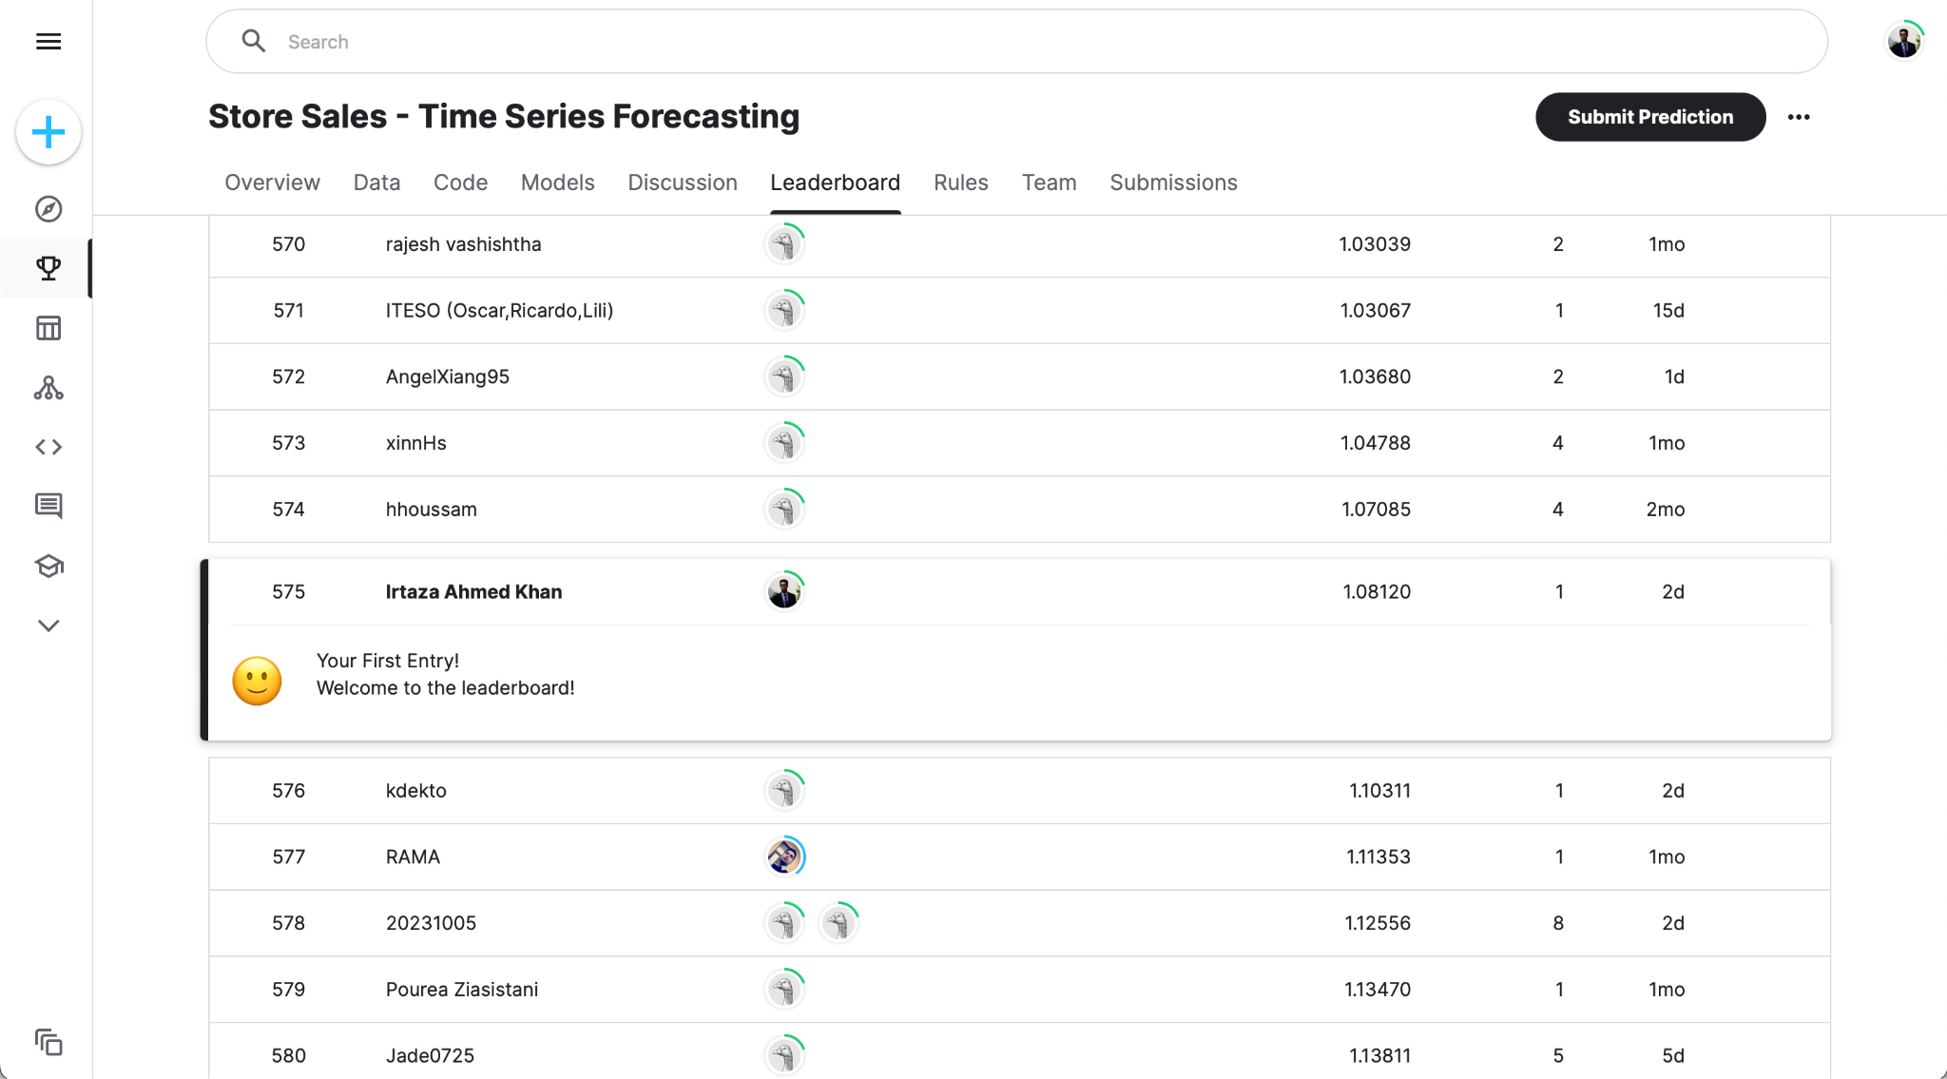
Model Training: XGBoost

Slide 17
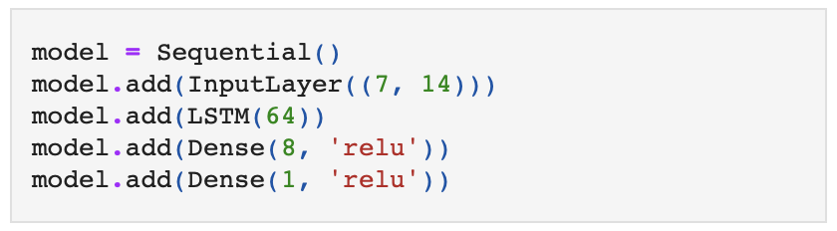
Model Training: LSTM (Multivariate)

Slide 18
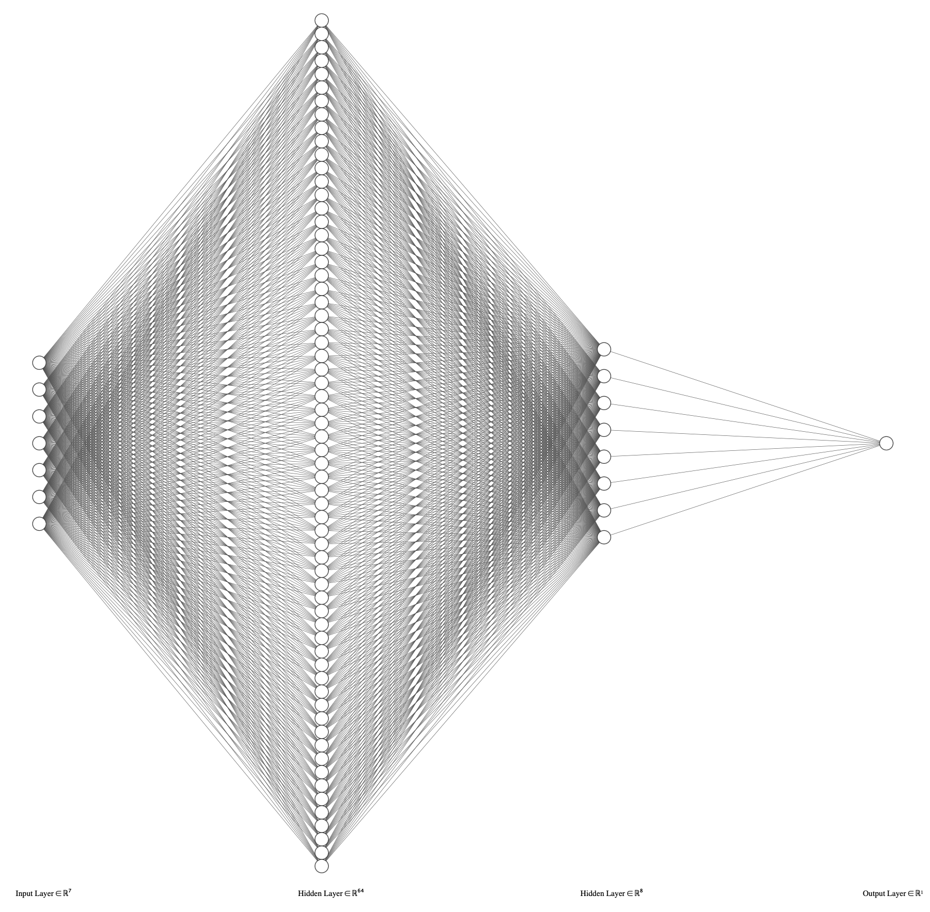
Model Training: LSTM (Multivariate)

Slide 19
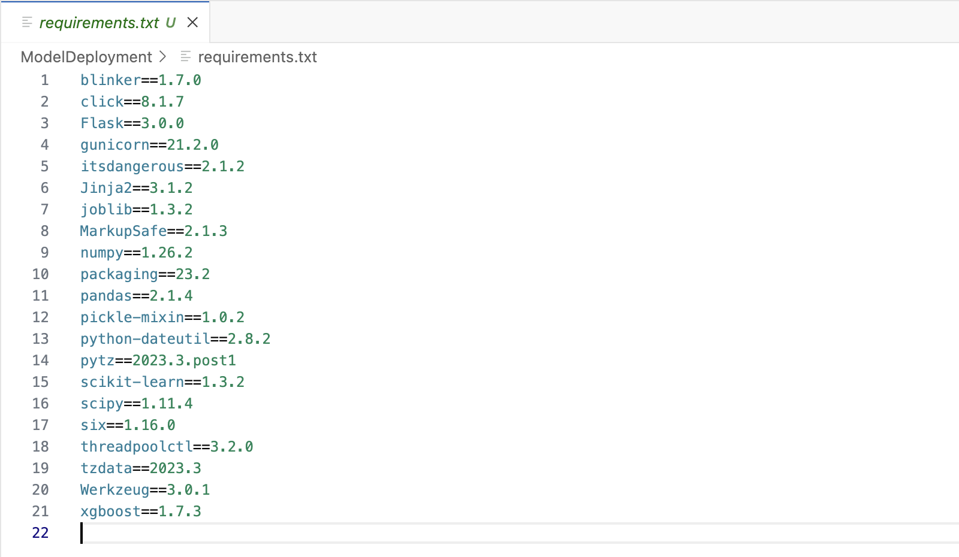
Deployment: Flask

Slide 20
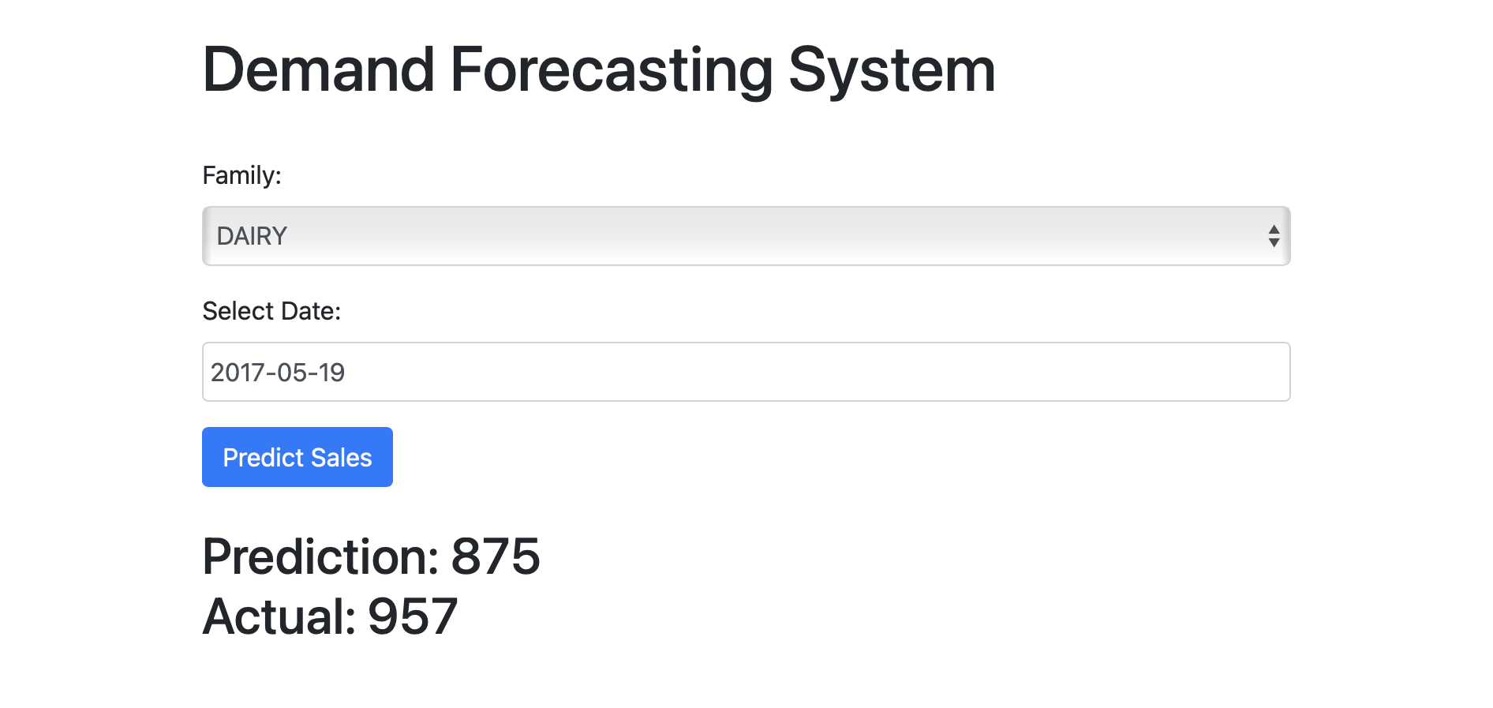
Deployment: Flask

Slide 21
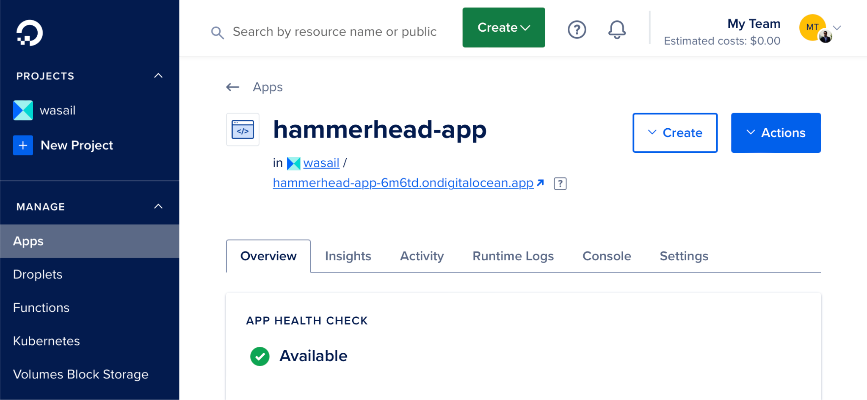
Deployment: Cloud

Slide 22
Back-End
Database Diagram
Architecture Diagram
Code
Postman Demo

Slide 23
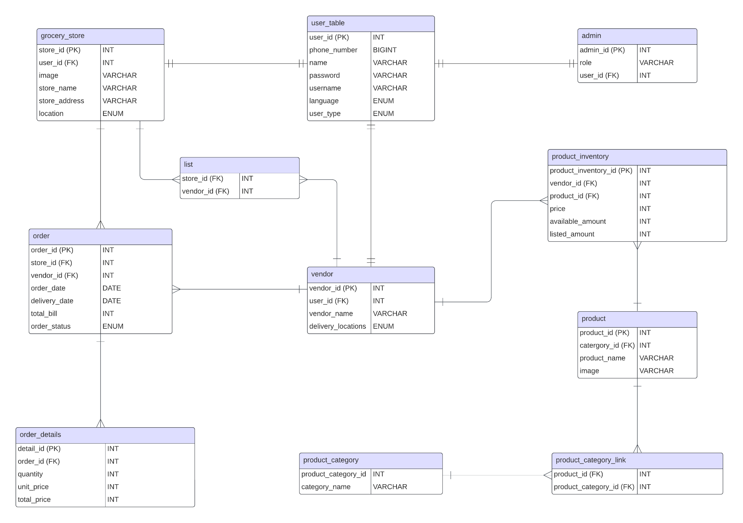
Database Diagram

Slide 24
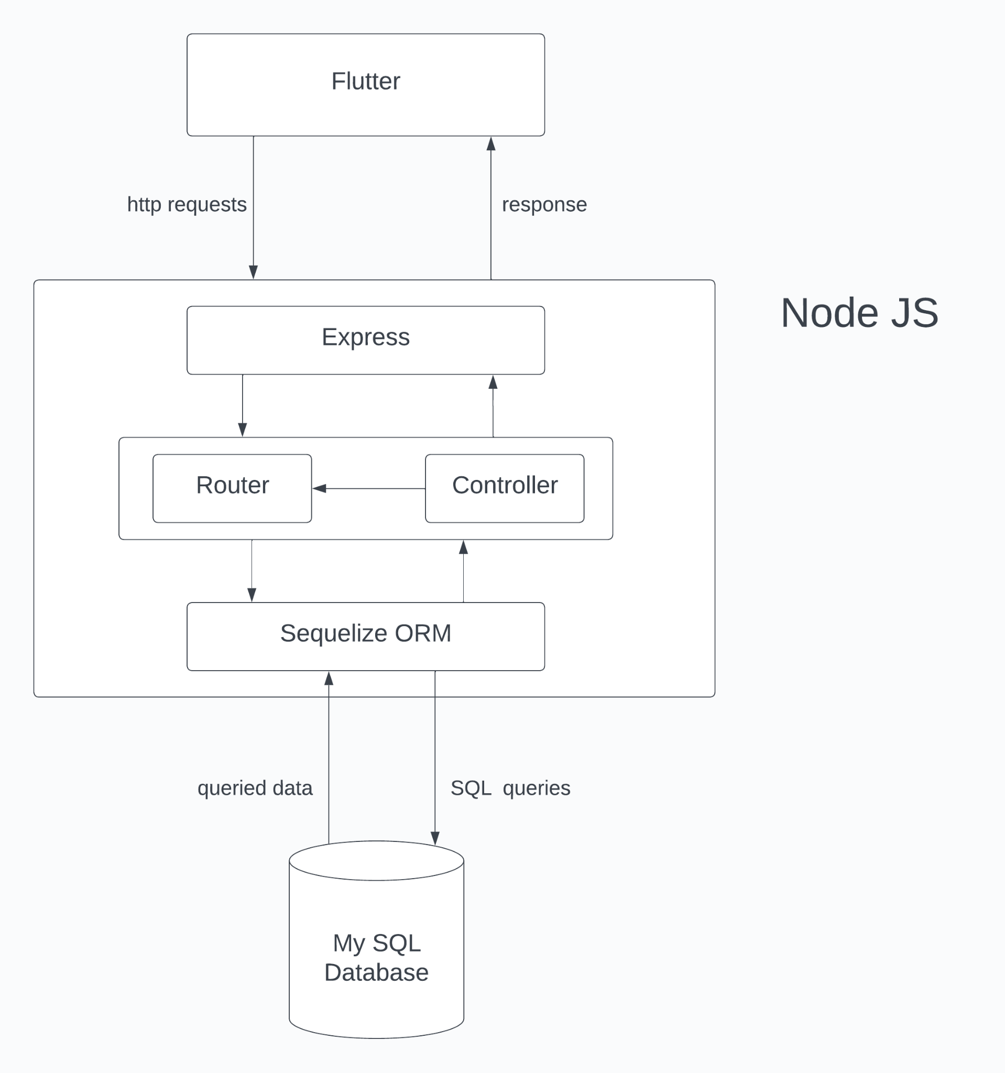
Architecture Diagram

Slide 25
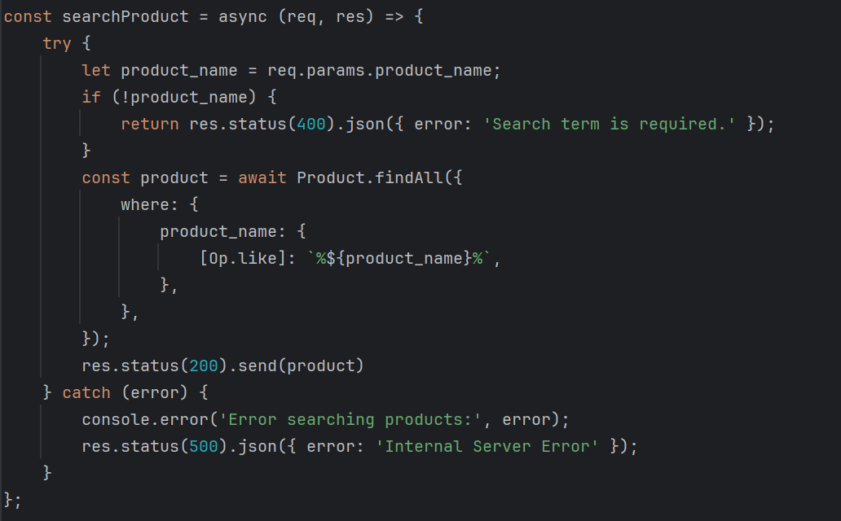
Code

Slide 26
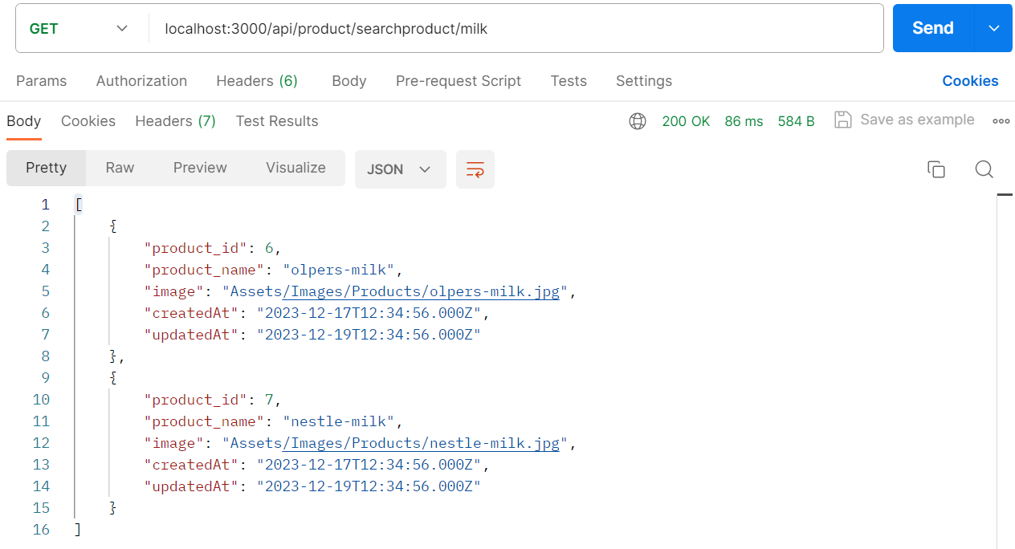
Postman Demo

Slide 27
Front-End
Prototype
Flutter / Dart
Internationalisation
Media Query
Provider & Consumer
REST API & HTTP Protocol (Integration)

Slide 28
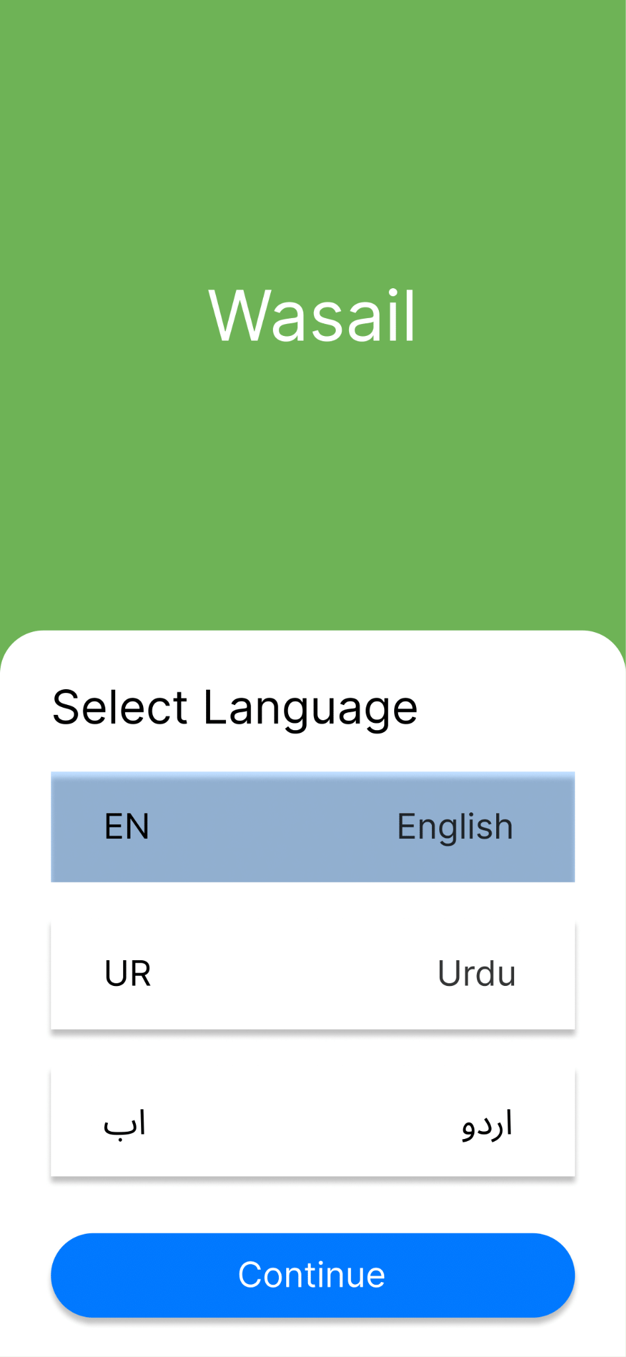
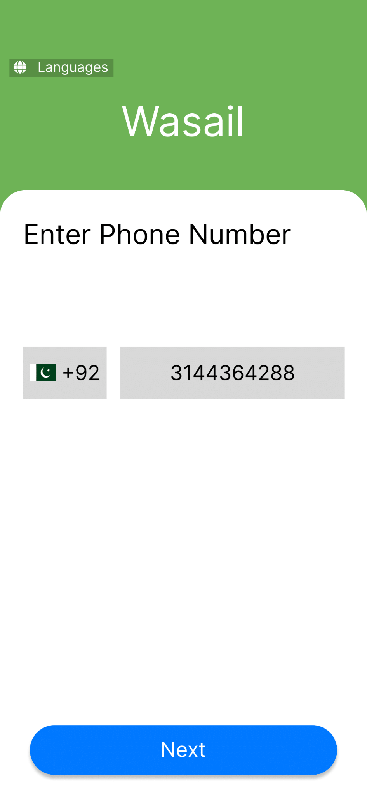
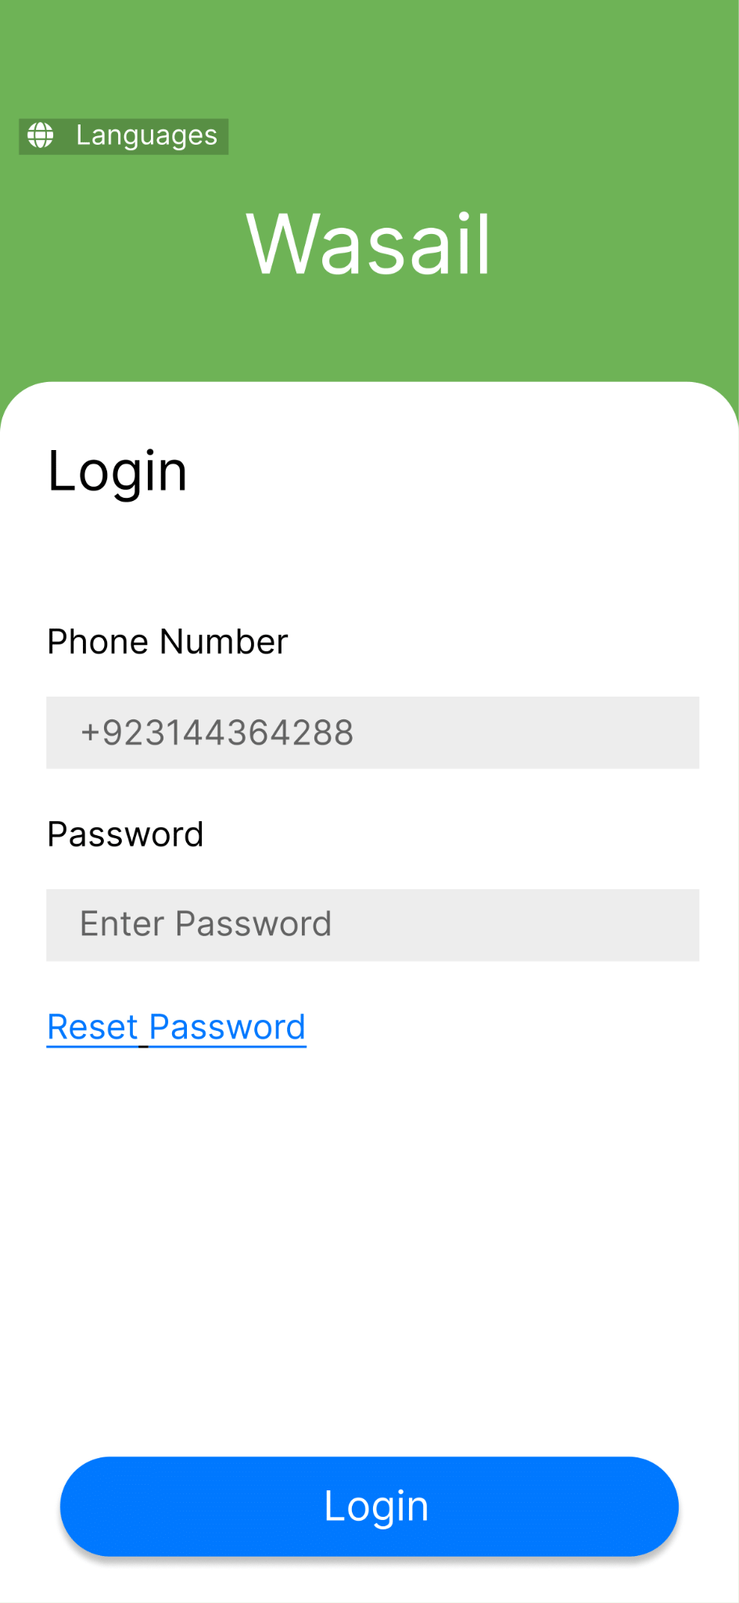
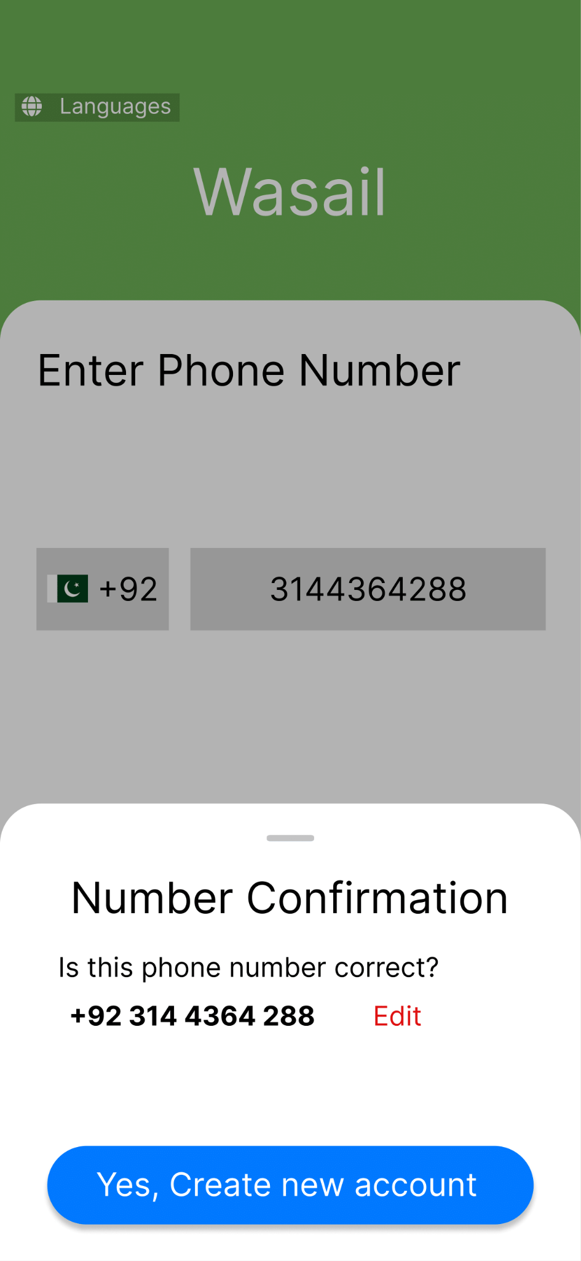
Prototype

Slide 29
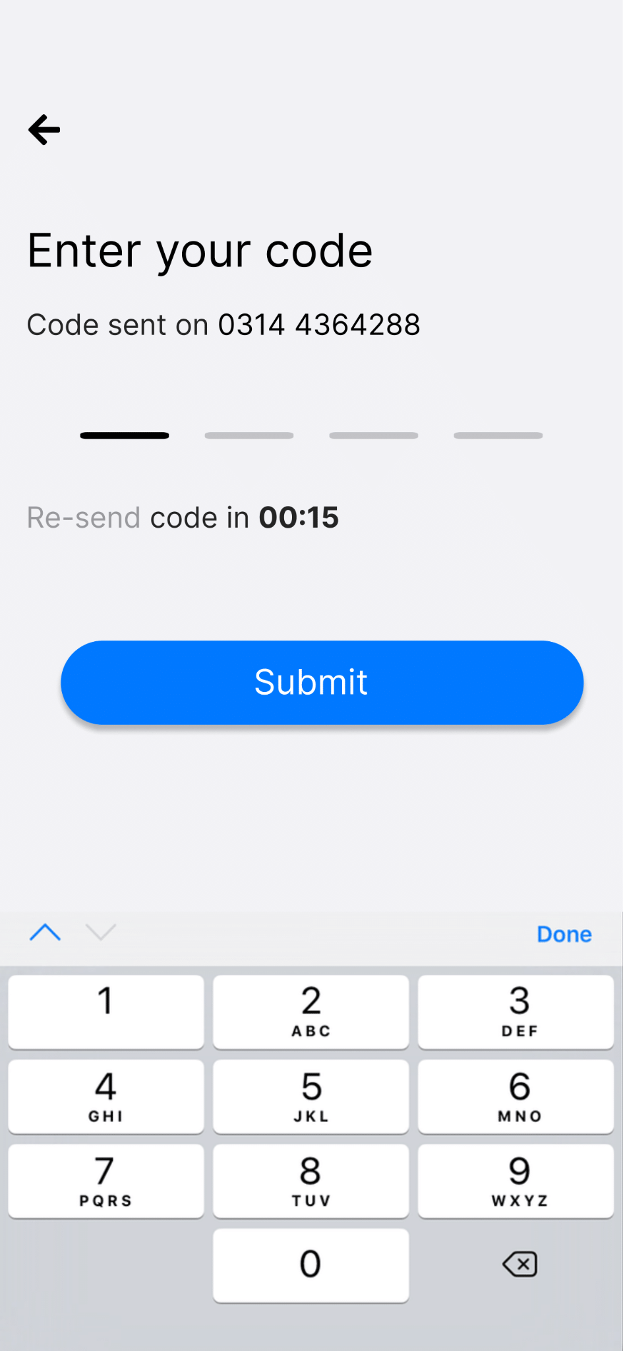
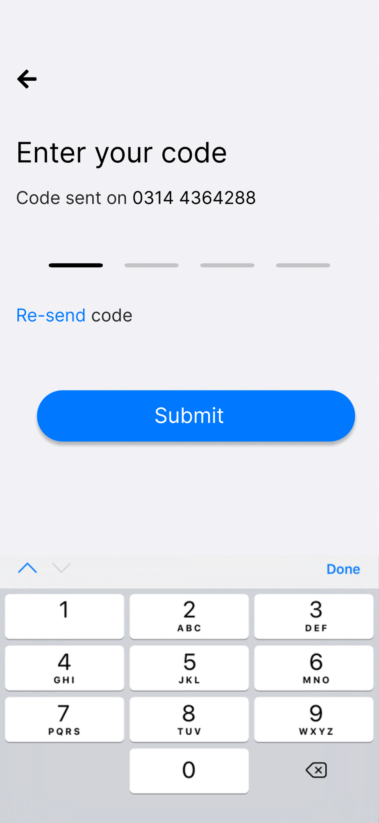
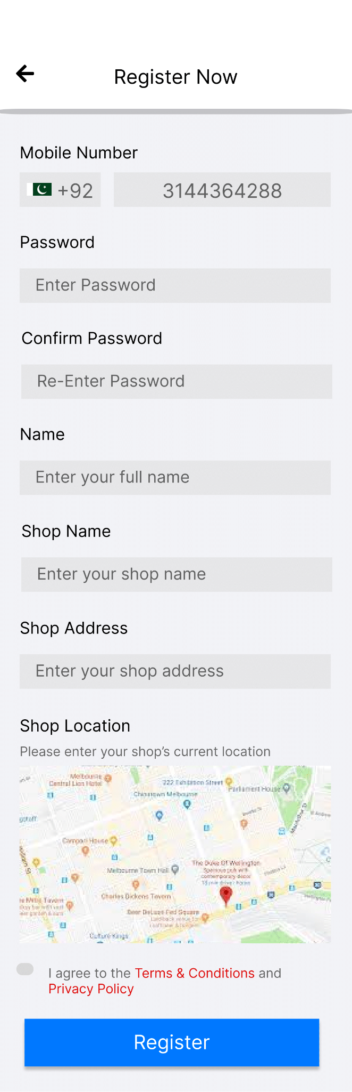
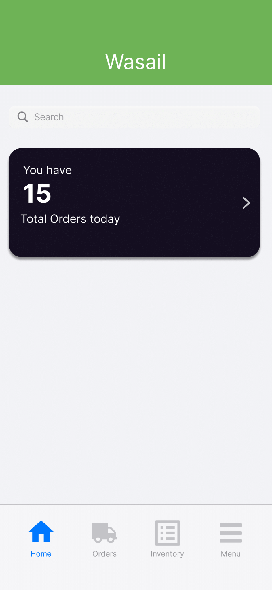
Prototype

Slide 30
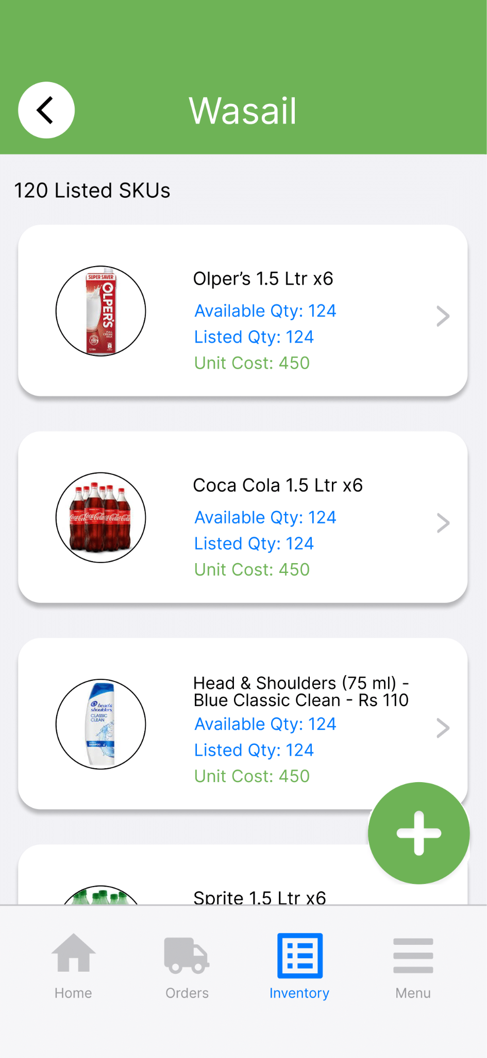
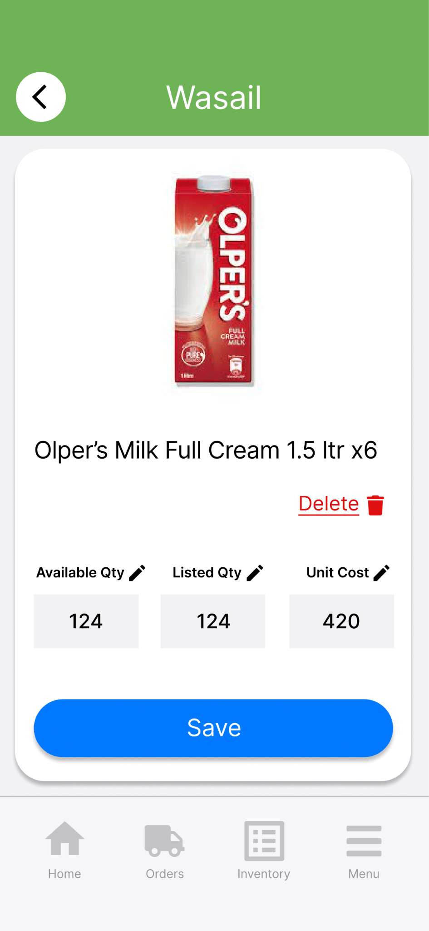
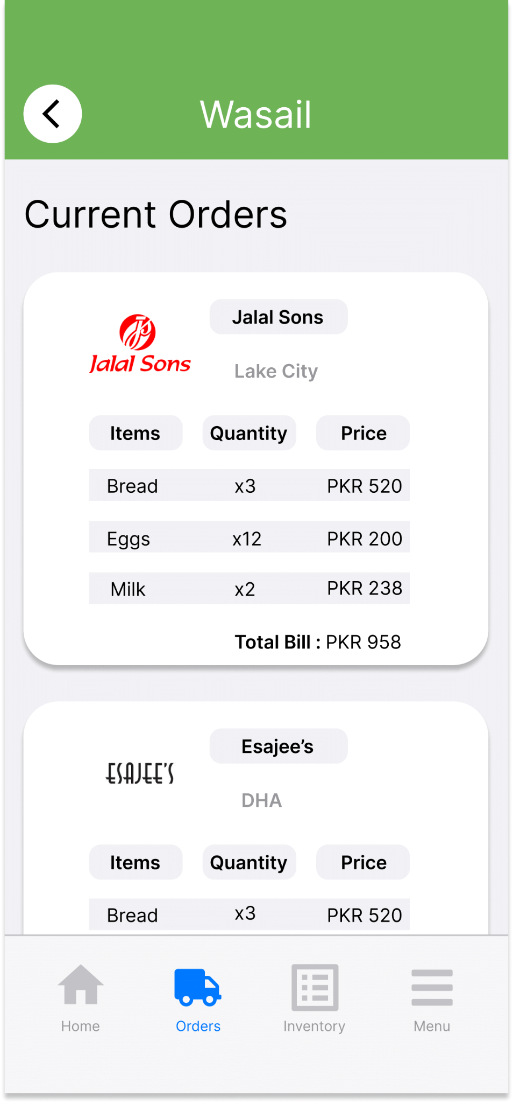
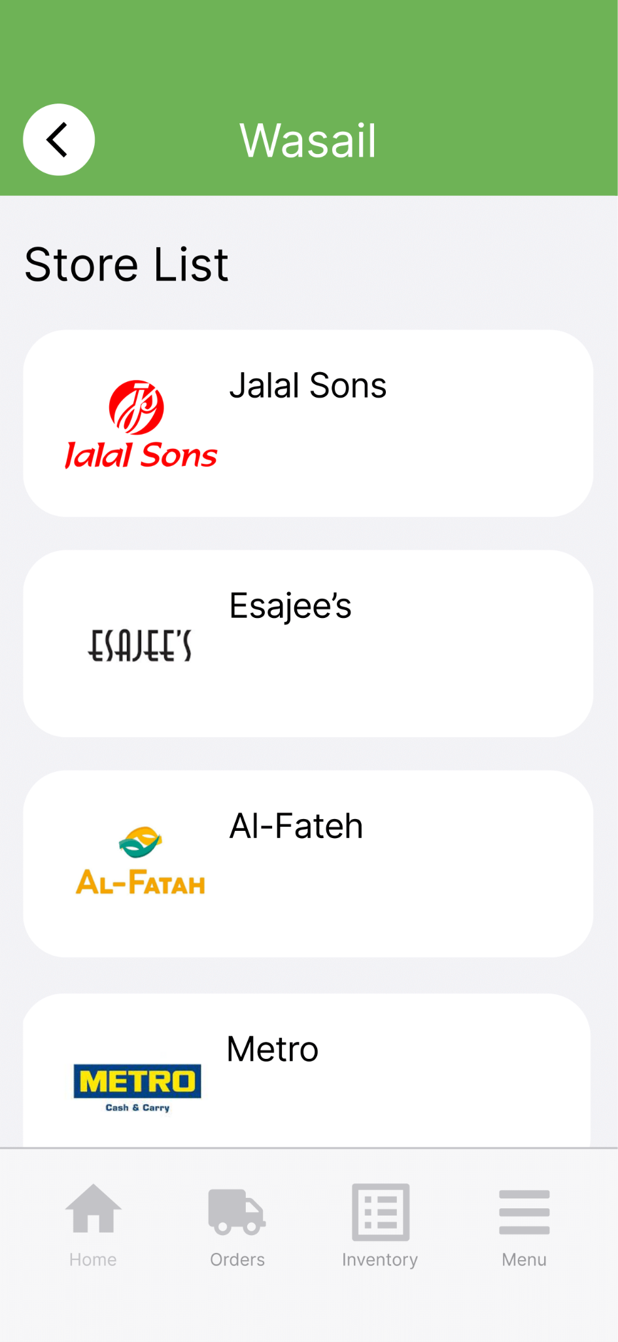
Prototype

Slide 31
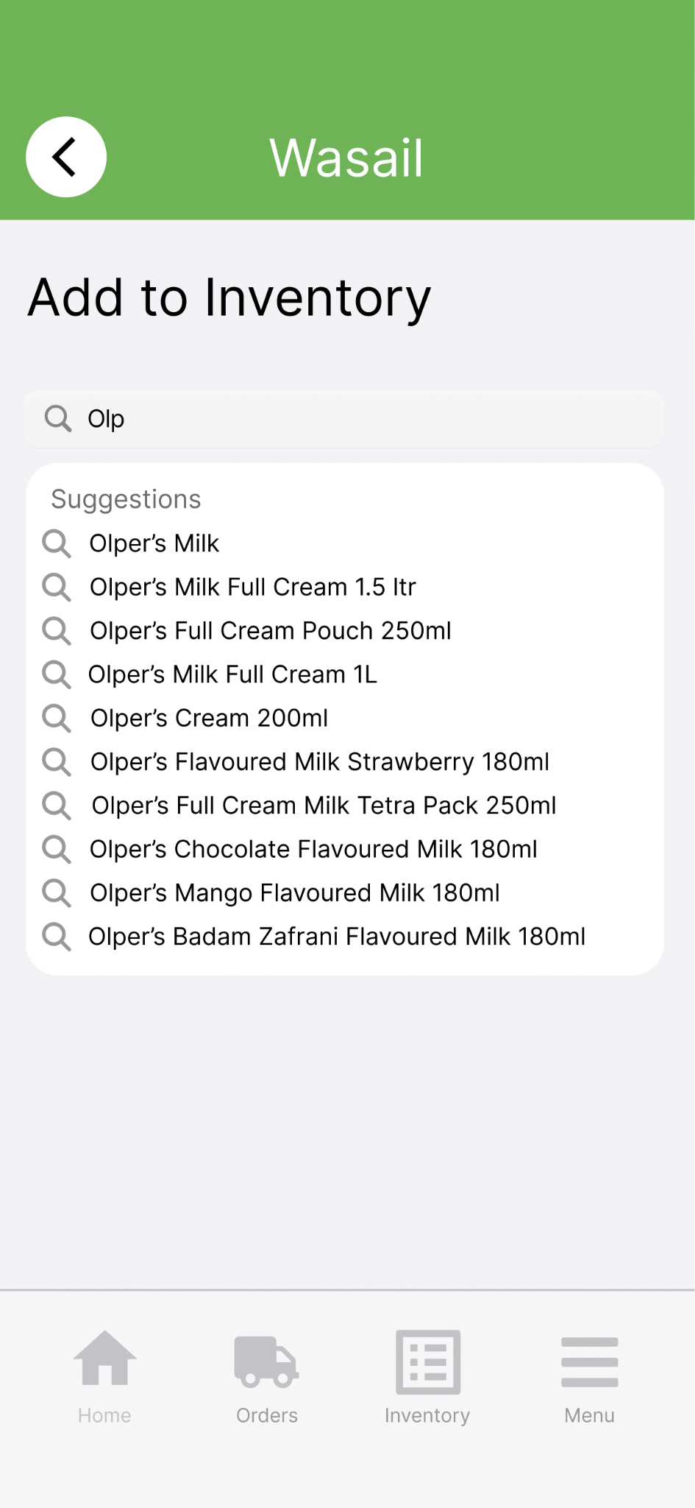
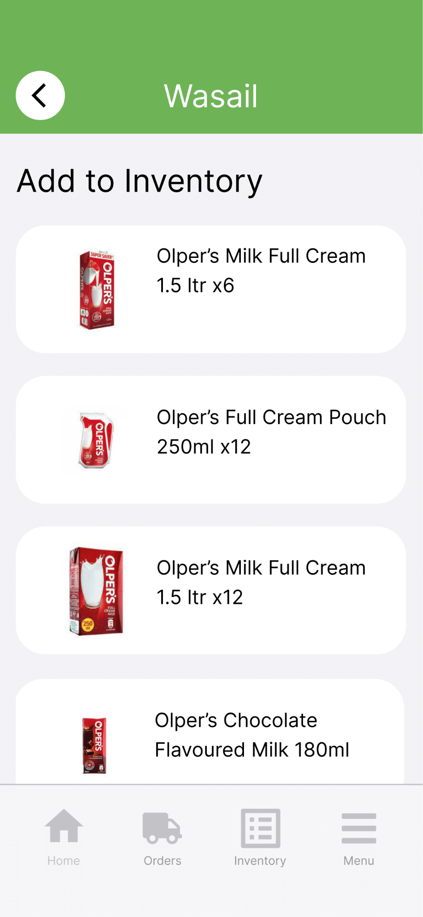
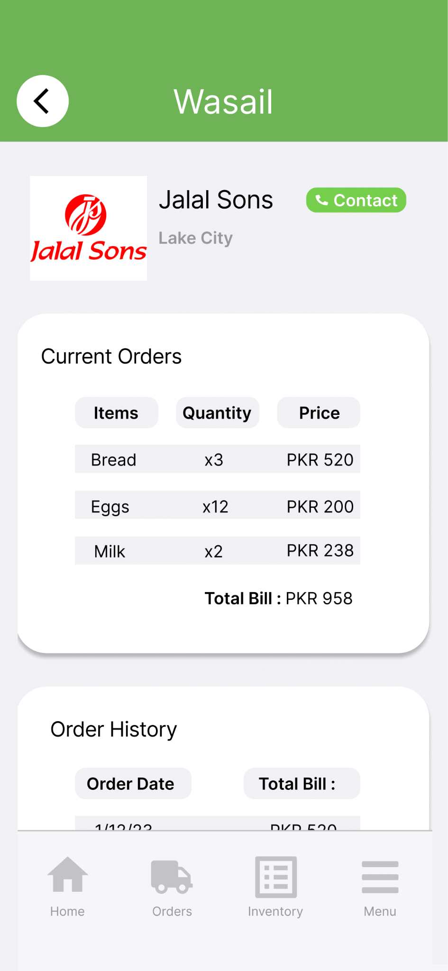
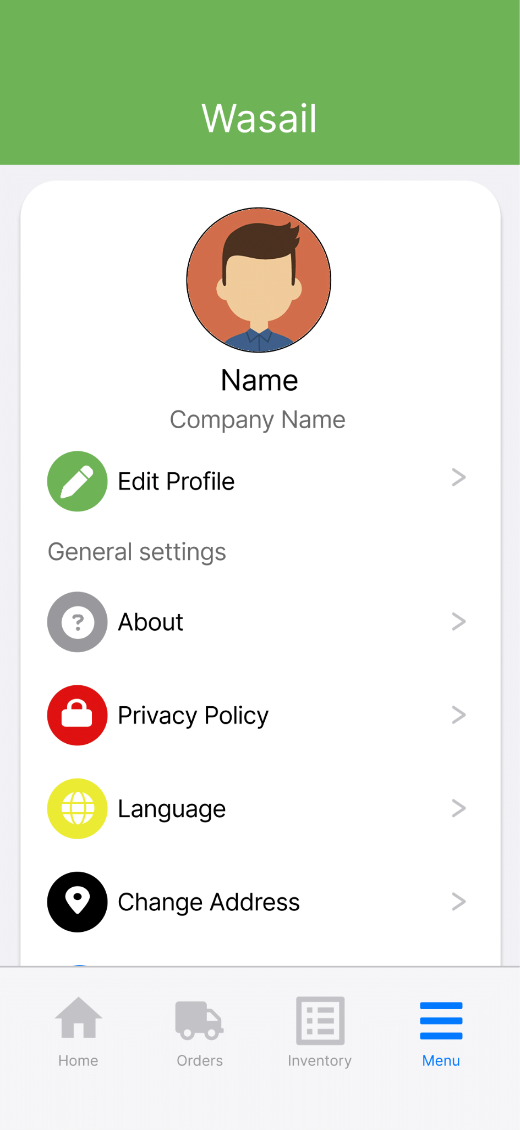
Prototype

Slide 32
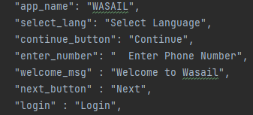
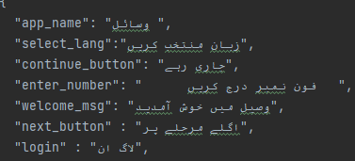
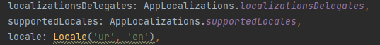
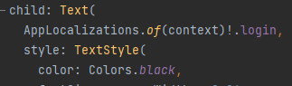
Internationalisation
Adapts apps for a global audience
Implements language-specific resources
Translates text, date formats, and elements for a personalized experience
ARB (Application Resource Bundle) - JSON syntax
i10n

Slide 33
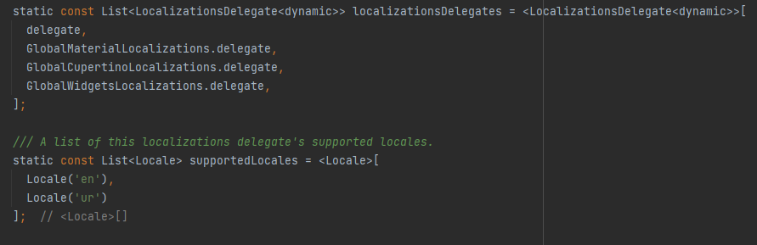
Internationalisation

Slide 34
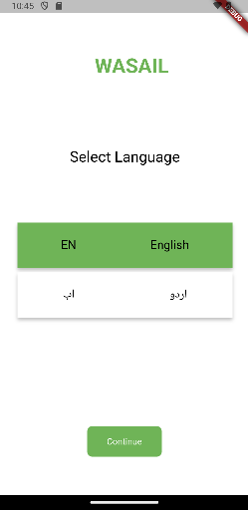
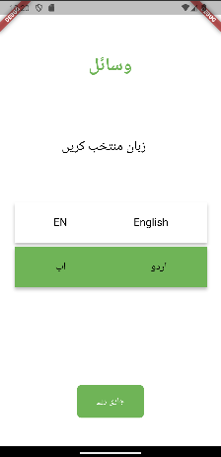
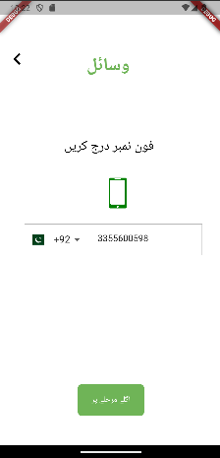
Internationalisation

Slide 35
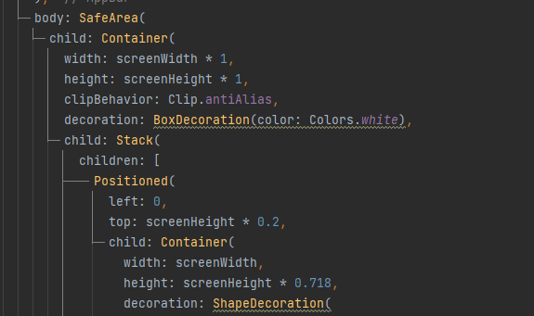
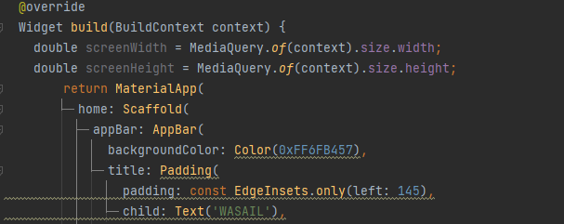
Media Query
Responsive design tool in Flutter
Creates adaptive layouts based on device characteristics
Dynamically adjusts UI for various screen sizes, resolutions, and orientations

Slide 36
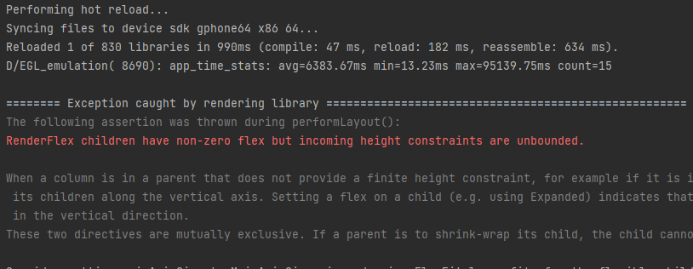
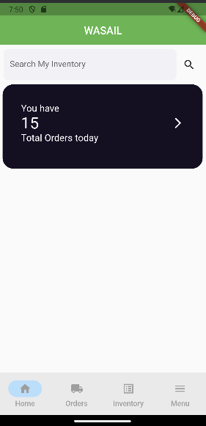


Media Query

Slide 37

Provider & Consumer
Manages app-wide state in Flutter
Providers hold shared state
Consumers efficiently listen for changes, enhancing reactivity
Used in our app as of right now for session maintenance, language and more

Slide 38

Provider & Consumer
Managing internationalisation, an example of using state management

Slide 39




REST API & HTTP Integration
Bridges frontend and backend communication
Integrates REST APIs using HTTP protocol (End points)
Enables fetching and sending data to servers for dynamic content and real-time updates

Slide 40
Demo…

